Slide 1

SIMPLE AND COMPOUND INTEREST

Slide 2
Simple Interest and Compound Interest
Concept of Simple Interest
Problems related to missing rate, principal and time for Simple Interest & Practice from PPT
Problems related to interest/amount being n times of Principal & Practice from PPT
Installments based Questions & Practise from PPT
Concept of Compound Interest
Problems related to missing rate, principal and time for Compound Interest & Practice from PPT
Concept of half yearly, quarterly interest and monthly & Practice from PPT
Problems related to interest/amount being n times of Principal & Practise from PPT
Difference between SI and CI for 2 and 3 years & Practice from PPT
Installments based Questions & Practise from PPT
Data Sufficiency Questions

Slide 3
INTEREST: It is money paid by a borrower for using the lender's money for a specified period of time. Denoted by ‘I’. PRINCIPAL: The original sum borrowed. Denoted by P. TIME: The time period for which the money is borrowed. Denoted by n RATE OF INTEREST: The rate at which interest is calculated on the original sum. Denoted by r. AMOUNT: Sum of Principal plus Interest. Denoted by A
SIMPLE AND COMPOUND INTEREST

Slide 4
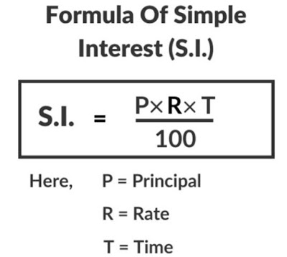
Simple Interest (S.I.) is the method of calculating the interest amount for a particular principal amount of money at some rate of interest.
SIMPLE AND COMPOUND INTEREST

Slide 5
SIMPLE AND COMPOUND INTEREST
1. Find the simple interest earned on ₹ 20,000 for 2 years at 10 % p. a?
A. ₹ 4500 B. ₹ 2000 C. ₹ 4000 D. ₹ 6000
Notes:
Answer: option C
Level: Easy (Compulsory)

Slide 6
SIMPLE AND COMPOUND INTEREST
2. Find the simple interest earned on ₹ 20,000 for 2 years 6 months at 10 % p. a?
A. ₹ 4500 B. ₹ 2000 C. ₹ 5,000 D. ₹ 6000
Notes:
Answer: option C
Level: Easy (Optional)

Slide 7
SIMPLE AND COMPOUND INTEREST
3. The interest for the 3rd year on a certain sum at a certain rate of simple interest is ₹ 3,000. Find the sum of the interests accrued on it the 6th, 7th and 8th years?
A. ₹ 6,000 B. ₹ 9,000 C. ₹ 4,500 D. ₹ 12,000
Notes:
Answer Option B
Easy (Optional)

Slide 8
SIMPLE AND COMPOUND INTEREST
4. What would a sum of ₹ 8,800 amount to in 16 years at a simple interest rate of 12 % every year?
A. ₹ 14,440 B. ₹ 18,846 C. ₹ 25,696 D. ₹ 32,322
Notes:
Answer: Option C
Easy (Optional)

Slide 9
SIMPLE AND COMPOUND INTEREST
5. Ashok has to deposit a total of ₹ 18,000 in two savings schemes of a bank, of which the first one yields a simple interest of 6 % p.a and the second one yields 8 % p.a. simple interest. How much should Ashok deposit in the first scheme so that the total amount deposited earns interest at a rate of 7.6 % p.a?
A. ₹ 4400 B. ₹ 3600 C. ₹ 7200 D. ₹ 5600
Notes:
Answer: Option B
Moderate (Compulsory)

Slide 10
SIMPLE AND COMPOUND INTEREST
6. A father left a will of ₹35 lakhs between his two daughters aged 8.5 and 16 such that they may get equal amounts when each of them reach the age of 21 years. The original amount of ₹35 lakhs has been instructed to be invested at 10% p.a. simple interest. How much did the elder daughter get at the time of the will?
A. ₹ 17.5 lakhs B. ₹ 21 lakhs C. ₹ 15 lakhs D. ₹ 20 lakhs
Notes:
Option B
Expert (Compulsory)

Slide 11
SIMPLE AND COMPOUND INTEREST
7. At simple interest, a sum becomes three times in 20 years. Find the time in which the sum will be double at the same rate of interest?
A. 8 years B. 10 years C. 12 years D. 14 years
Notes:
Option B
Easy (Compulsory)

Slide 12
SIMPLE AND COMPOUND INTEREST
8. Abhay borrowed some money form Ajay at 15 % per annum simple interest. He then added some more amount and lent to Vijay at 20 % per annum simple interest. At the end of the year, the difference between the interest received and paid by Abhay is ₹ 325. If Abhay lent ₹ 3,500 to Vijay, then how much loan did Abhay take from Ajay?
A. ₹ 1,000 B. ₹ 1,800 C. ₹ 2,200 D. ₹ 2,500
Notes:
Answer: Option D
Expert (Compulsory)

Slide 13
SIMPLE AND COMPOUND INTEREST
9. Sachin would have paid ₹ 5280 at the end of 4 years, for a sum of money borrowed, at rate of 8% p.a. S.I. If he wants to repay his loan a year before its due, then what is the amount paid by him?
A. ₹ 5060 B. ₹ 4960 C. ₹ 4760 D. ₹ 4670
Notes:
Option B
Moderate (Compulsory)

Slide 14
SIMPLE AND COMPOUND INTEREST
10. Some amount was lent at 10% p.a Simple Interest. After 1 year, ₹ 4400 is repaid and the rest of the amount is repaid at 20% p.a. If the 2nd year’s interest is 11/7 of the first year’s interest, find the amount of money that was lent out initially ?
A. ₹ 12000 B. ₹ 13000 C. ₹ 14000 D. ₹ 15000
Notes:
Option C
Expert (Optional)

Slide 15
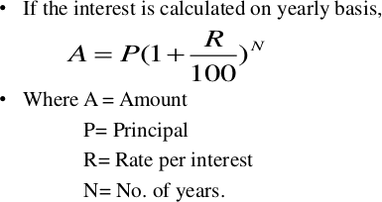
Compound interest is based on the principal amount and the interest that accumulates on it in every period. CI = A - P

Slide 16
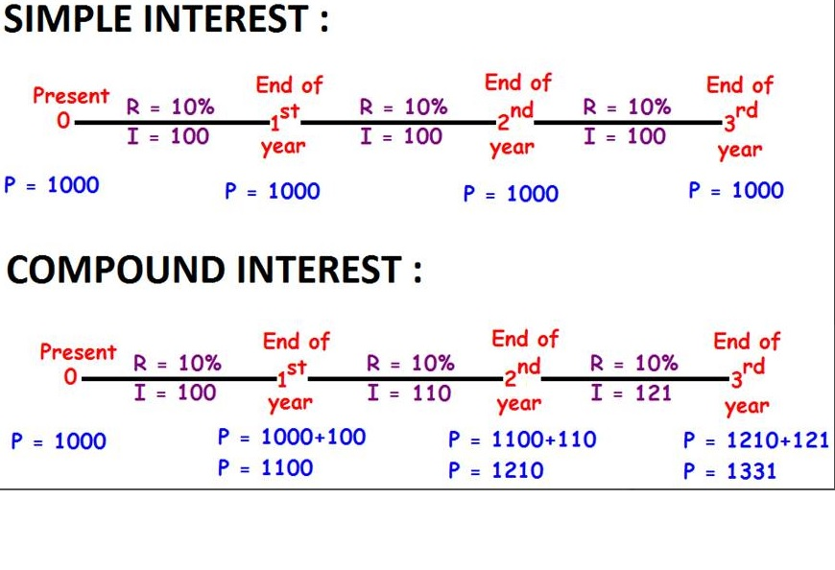

Slide 17
IMPORTANT FORMULAS:
When the interest is compounded Annually:
Amount= P (1 + R/100) ^{n}
When the interest is compounded Half-yearly:
Amount = P (1 + (R/2)/100)^{2n}
When the interest is compounded Quarterly:
Amount = P (1 + (R/4)/100)^{4n}
When the rates are different for different years, say R1%, R2%, and R3% for 1 year, 2 years, and 3-year resp. Then,
Amount = P (1 + R1/100) (1 + R2/100) (1 + R3/100)
Present worth of ₹ x due n years hence is given by:
Present worth = x/ (1 + R/100)^{n}

Slide 18
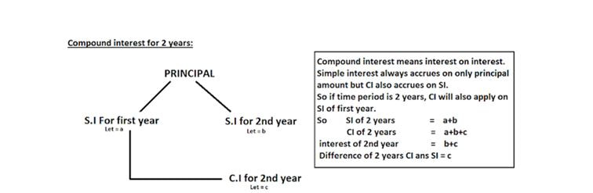
Compound interest for 2 years

Slide 19
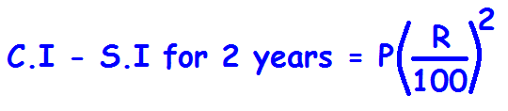
Difference between CI and SI for 2 years:
sum
A
A
B
Int. for 1st year
Int. for 2nd year

Slide 20
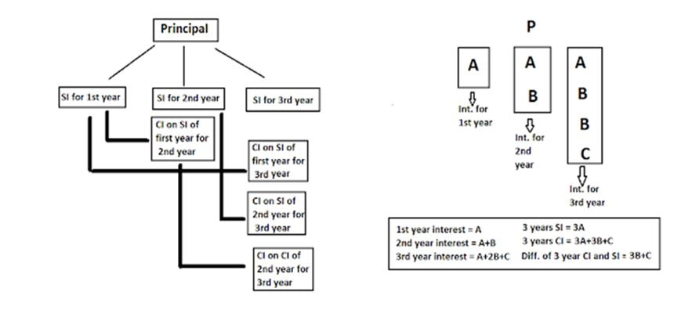
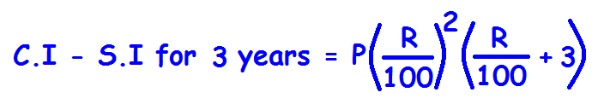
Compound interest for 3 years

Slide 21
SIMPLE AND COMPOUND INTEREST
11.A certain sum of money amounts to ₹1210 in 2 years and to ₹1331 in 3 years at compound interest. find the rate of interest.
A. 10% B. 11% C. 12% D. 13%
Notes:
Option A
Easy (Compulsory)

Slide 22
SIMPLE AND COMPOUND INTEREST
12. The sum that amounts to ₹ 2704 in 2 yrs at 4% per annum CI compounded annually is:
A. ₹ 2200 B. ₹ 3200 C. ₹ 2500 D. ₹ 2800
Notes:
Option C
Easy (Optional)

Slide 23
SIMPLE AND COMPOUND INTEREST
13. The sum that amounts to ₹ 2541 in 2 yrs 6 months at 10% per annum CI compounded annually is:
A. ₹ 2000 B. ₹ 3200 C. ₹ 2500 D. ₹ 2800
Notes:
Option a
Easy (Optional)

Slide 24
SIMPLE AND COMPOUND INTEREST
14. Ahuja invested ₹4000 in a fixed deposit scheme for 2 years at CI rate 10% per annum. How much amount(in ₹) will Ahuja get on maturity of the fixed deposit?
A. 4730 B. 4690 C. 4840 D. 4880
Notes:
Answer: Option C
Easy (Compulsory)

Slide 25
SIMPLE AND COMPOUND INTEREST
15. If ₹18000 amounts to ₹ 22579.20 in 2 yrs compounded annually, then find the rate of interest per annum?
A. 8% B. 10% C. 14% D. 12%
Notes:
Answer: Option D
Easy (Compulsory)

Slide 26
SIMPLE AND COMPOUND INTEREST
16. What total will be amount to ₹ 51516 at compound interest in 2 years, the rate of interest for 1st & 2nd year being 6% and 8% respectively?
A. ₹ 35000 B. ₹ 40000 C. ₹ 38000 D. ₹ 45000
Notes:
Option D
Easy (Optional)

Slide 27
SIMPLE AND COMPOUND INTEREST
17. The principal that amounts to ₹ 4913 in 3 years at 6.25% per annum compound interest compounded annually is:
A. ₹ 3096 B. ₹ 4076 C. ₹ 4085 D. ₹ 4096
Notes:
Option D
Easy (Optional)

Slide 28
SIMPLE AND COMPOUND INTEREST
18. Kavitha borrowed ₹ 72000 from karuna and kalyani. Karuna charges 12% p.a. and kalyani charges 7% p.a. compound interest. At the end of a year kavita paid ₹ 6120 as interest. Find the sum borrowed from kalyani?
A. ₹ 48600 B. ₹ 50400 C. ₹ 49200 D. ₹ 51300
Notes:
Option B
Moderate (Optional)

Slide 29
SIMPLE AND COMPOUND INTEREST
19. The sum that amounts to ₹ 8820 in 1 yr at 10% per annum CI compounded half -yearly is:
A. ₹ 8000 B. ₹ 8200 C. ₹ 2500 D. ₹ 2800
Notes:
Option a
Moderate (Compulsory)

Slide 30
SIMPLE AND COMPOUND INTEREST
20. The sum that amounts to ₹ 1331 in 1 yr 6months at 20% per annum CI compounded half -yearly is:
A. ₹ 1000 B. ₹ 1100 C. ₹ 1120 D. ₹ 1200
Notes:
Option a
Moderate (Optional)

Slide 31
SIMPLE AND COMPOUND INTEREST
21. Find the compound interest when $1,25,000 is invested for 9 months at 8% per annum, compounded quarterly.
A. ₹ 4000 B. ₹ 4200 C. ₹ 7651 D. ₹ 7653
Notes:
Option c
Moderate (Compulsory)

Slide 32
SIMPLE AND COMPOUND INTEREST
22. What is the difference between the compound interest on ₹ 5000 for 1.5 years at 4% per annum compounded yearly and half-yearly?
A. ₹ 2.04 B. ₹ 3.06 C. ₹ 4.80 D. ₹ 8.30
Notes:
Answer: Option A
Moderate (Compulsory)

Slide 33
SIMPLE AND COMPOUND INTEREST
23. A bank offers 5% p.a. compound interest calculated on half-yearly basis. A customer deposits ₹ 1600 each on 1st January and 1st July of a year. At the end of the year, the amount he would have gained by way of interest is:
A. ₹ 120 B. ₹ 121 C. ₹ 122 D. ₹ 123
Notes:
Option B
Moderate (Optional)

Slide 34
SIMPLE AND COMPOUND INTEREST
27. A sum of money under compound interest doubles itself in 4 years. In how many years will it become 16 times of itself?
A. 12 years B. 16 years C. 8 years D. None of these
Notes:
Answer: Option B
Easy (Compulsory)

Slide 35
SIMPLE AND COMPOUND INTEREST
24. The difference between the interest earned under compound interest, interest being compounded annually and simple interest for two years on the same sum at the same rate of interest is ₹ 25.60. Find the sum if the rate of interest is 8 % p.a. ?
A. ₹ 2000 B. ₹ 2500 C. ₹ 3200 D. ₹ 4000
Notes:
Answer: Option D
Moderate (Compulsory)

Slide 36
SIMPLE AND COMPOUND INTEREST
25. The simple interest on a certain sum of money for 3 years at 8 % per annum is half the compound interest on ₹ 8000 for 2 years at 10 % per annum. Find the sum on which simple interest is calculated:
A. ₹ 3500 B. ₹ 3800 C. ₹ 4000 D. ₹ 3600
Notes:
Option A
Moderate (Optional)

Slide 37
SIMPLE AND COMPOUND INTEREST
26. The compound interest on a sum for 2 years is ₹ 832 and the simple interest on the same sum for the same period is ₹ 800. The difference between the compound and simple interest for 3 years will be ?
A. ₹ 48 B. ₹ 66.56 C. ₹ 98.56 D. None of these
Notes:
Option C
Moderate (Compulsory)

Slide 38
SIMPLE AND COMPOUND INTEREST
28. A person invested a sum of ₹P for 2 years, which is compounded annually at a rate of r% p a. Another person invested the same sum for same period at same rate at simple interest. The difference in their amounts after 2 years is found to be ₹4P. Find the rate of interest at which they have invested their sums?
A. 100% B. 150% C. 200% D. None of these
Notes:
Option C
Expert (Optional)

Slide 39
SIMPLE AND COMPOUND INTEREST
29. A person deposited a sum of ₹ 10000 in a bank for a period of n1 years at a rate of 20% p.a. compounded annually. The same person deposited a sum of ₹ 11520 in other bank for a period of n2 years at a rate of 25% p.a. simple interest. The amounts received from the two banks are equal and the total amount is ₹ 34560. Find n1 and n2?
A. n1=3, n2= 2 B. n1= 2, n2= 2 C. n1= 1, n2= 3 D. Can’t be determined
Notes:
Option A
Expert (Optional)

Slide 40
SIMPLE AND COMPOUND INTEREST
30. A man borrowed ₹80000 at the rate of 10% p.a. , interest being compounded annually. How much amount should he have repaid at the end of the first year, if by repaying ₹55000 at the end of the second year he can clear the loan?
A. ₹ 38000 B. ₹ 33000 C. ₹ 45000 D. ₹ 50000
Notes:
Option A
Expert (Compulsory)

Slide 41
SIMPLE AND COMPOUND INTEREST
31. Ramesh takes a loan of ₹ 20000 from Karan at a simple interest of 20%. He agrees to clear the loan, along with the interest, in four equal installments, each at the end of one year, for four years. But, Karan puts forward a condition that he will continue to calculate the interest on the original amount lended till Ramesh completely pays off his loan. What is the value of each installment?
A. ₹ 9000 B. ₹ 9500 C. ₹ 10000 D. None of these
Notes:
Option A
Expert (Optional)

Slide 42
SIMPLE AND COMPOUND INTEREST
32. A sum of ₹ 13360 was borrowed at 8 ³/₄% per annum compound interest and paid back in two years in two equal installments. What was the amount of each installment?
A. ₹ 7500 B. ₹ 5769 C. ₹ 7569 D. ₹ 7009
Notes:
Option C
Expert (Optional)

Slide 43
SIMPLE AND COMPOUND INTEREST
33. What will be compounded amount?
I. ₹ 200 was borrowed for 192 months at 6% compounded annually.
II. ₹ 200 was borrowed for 16 years at 6%.
I alone sufficient while II alone not sufficient to answer
II alone sufficient while I alone not sufficient to answer
Either I or II alone sufficient to answer
Both I and II are not sufficient to answer
Both I and II are necessary to answer
Notes:
Option C
Easy (Compulsory)

Slide 44
SIMPLE AND COMPOUND INTEREST
34. An amount of money was lent for 3 years. What will be the difference between the simple and the compound interest on it at the same rate ?
I. The rate of interest was 8 p.c.p.a.
II. The total amount of simple interest was ₹ 1200.
I alone sufficient while II alone not sufficient to answer
II alone sufficient while I alone not sufficient to answer
Either I or II alone sufficient to answer
Both I and II are not sufficient to answer
Both I and II are necessary to answer
Notes:
Option E
Easy (Optional)

Slide 45
SIMPLE AND COMPOUND INTEREST
35. What will be the compound interest earned on an amount of ₹ 5000 in 2 years?
I. The simple interest on the same amount at the same rate of interest in 5 years is ₹ 2000.
II. The compound interest and the simple interest earned in one year is the same.
III. The amount become more than double on compound interest in 10 years.
I only
I and II only
II and III only
I and III only
None of these
Notes:
Option A
Moderate (Compulsory)

Slide 46
SIMPLE AND COMPOUND INTEREST
36. Mr. Gupta borrowed a sum of money on compound interest. What will be the amount to be repaid if he is repaying the entire amount at the end of 2 years?
I. The rate of interest is 5 p.c.p.a.
II. Simple interest fetched on the same amount in one year is ₹ 600.
III. The amount borrowed is 10 times the simple interest in 2 years.
I only
III only
I or II only
II and Either I or III only
All I, II and III are required
Notes:
Option D
Moderate (Optional)

Slide 47
SIMPLE AND COMPOUND INTEREST
37. What is the compound interest earned at the end of 3 years?
I. Simple interest earned on that amount at the same rate and for the same period is ₹ 4500.
II. The rate of interest is 10 p.c.p.a.
III. Compound interest for 3 years is more than the simple interest for that period by ₹ 465.
I and II only
II and III only
I and III only
I and Either II or III only
Any two of the three
Notes:
Option E
Moderate (Optional)

Slide 48
Any Doubts???

